Slide 1
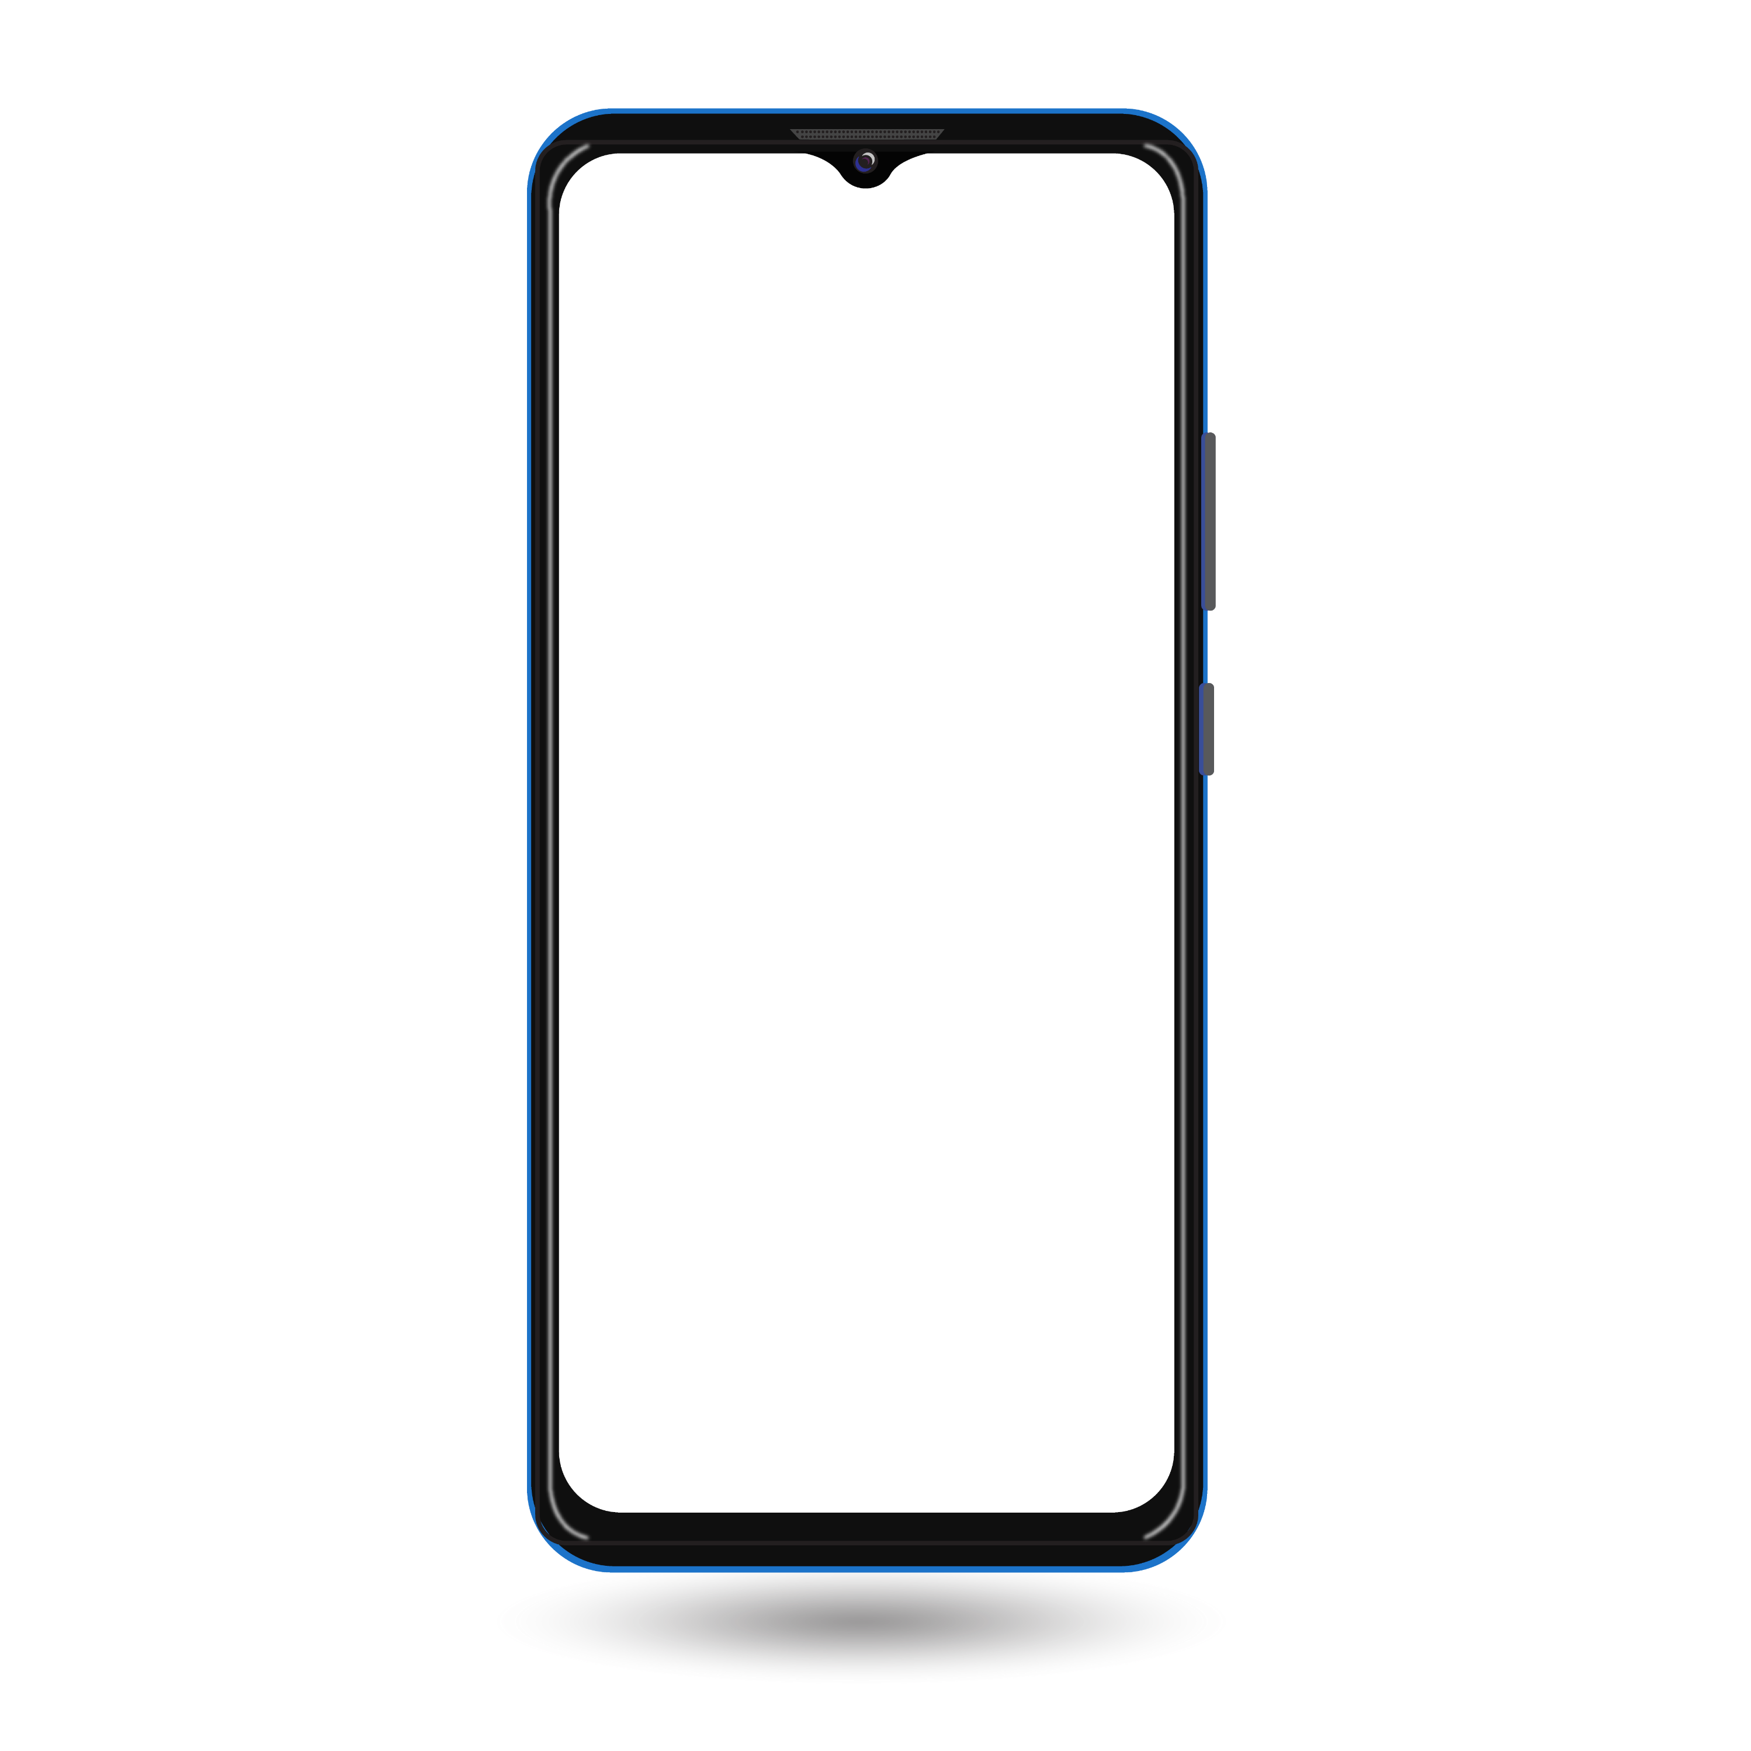

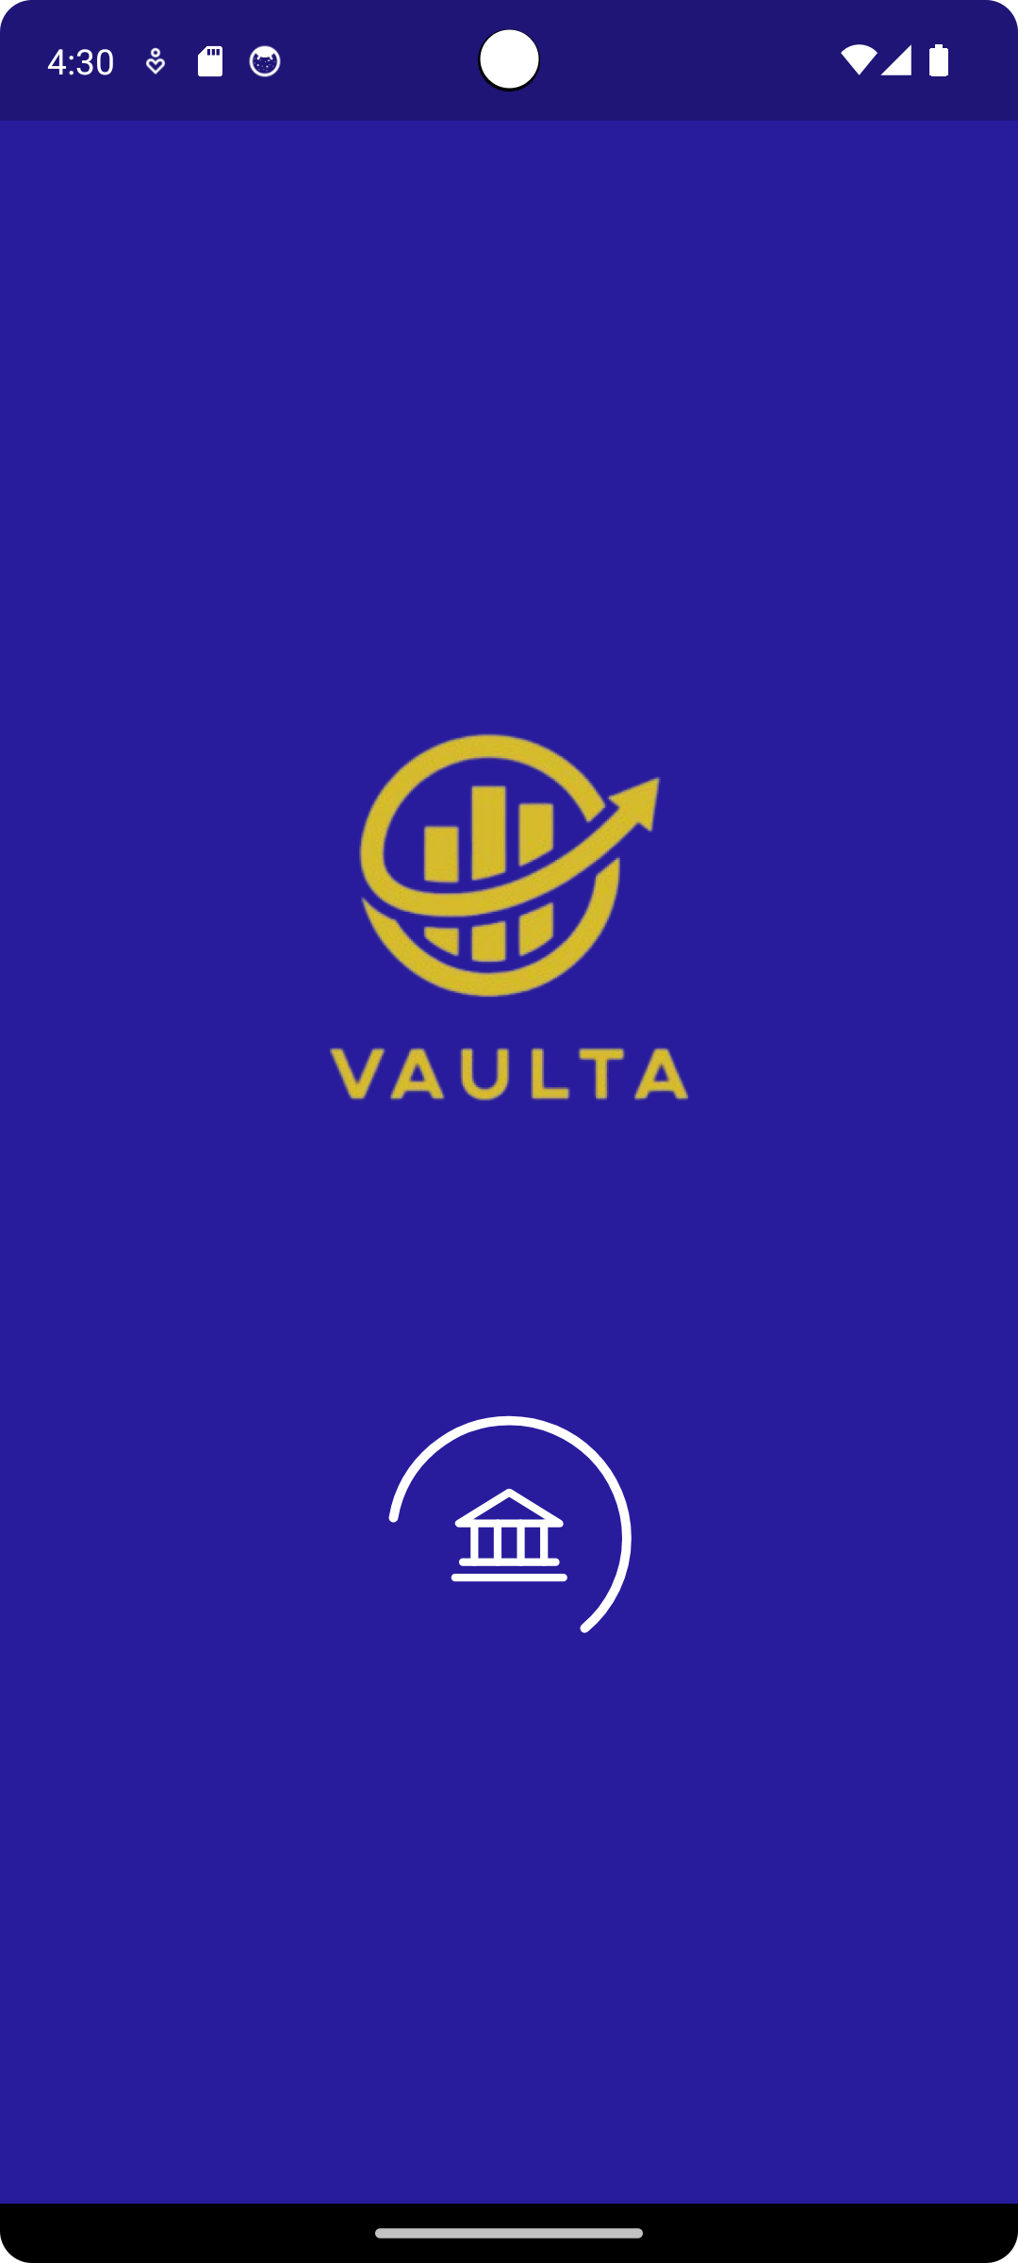
VAULTA
REVOLUTIONIZING MOBILE PAYMENTS

Slide 2
Project title: Vaulta
Technical provider: AST
Group Code: CAI1_SWD4_S9d
Team members:
Ahmed Salah
Ehab Mohamed Gamal
Ruaa Ihab Talaat
Alzahraa Walid
Aalaa Alaa

Slide 3
Ehab Mohamed Gamal:
Login & Registration UI.
Login & Registration validation.
Transaction history UI.
Ahmed Salah-Eldin:
Login & Registration backend.
Transaction history backend.
withdraw UI & backend.
Bills backend.
Onboarding screen.
Transfer backend.
Choose language UI & backend.

Slide 4
Ruaa Ehab Talaat:
Account UI(card tab UI),
Exchange Screen.
Home Screen UI.
Transaction History UI.
Alzahraa Walid:
Transfer UI.
Bills UI.

Slide 5
Aalaa Alaa:
Settings screen UI & backend.
Profile information UI & backend.
Edit profile UI & backend.
App info UI.
Language UI & backend.
Account tab UI & backend.

Slide 6
Agenda
1
Why VAULTA
.
2
Problem Statement
3
App Features
4
Summary

Slide 7

VAULTA?
VAULTA is a coined name inspired by the word vault, which refers to a secure place where valuables, especially money, are stored. Adding the suffix "-a" gives the name a modern and tech-savvy feel, making it sound innovative and appealing for a financial or banking app. It suggests security, trust, and safeguarding your money, while also implying ease of access and functionality in a digital platform.

Slide 8
Managing personal finances through traditional banking systems can be cumbersome and inefficient, especially when it comes to tasks like bill payments, money transfers, and tracking transactions. Users need a secure, easy-to-use platform to handle their financial activities conveniently.
VAULTA offers a streamlined mobile solution, enabling users to securely manage their funds, pay bills, transfer money, and view exchange rates, all from one intuitive app.

Slide 9

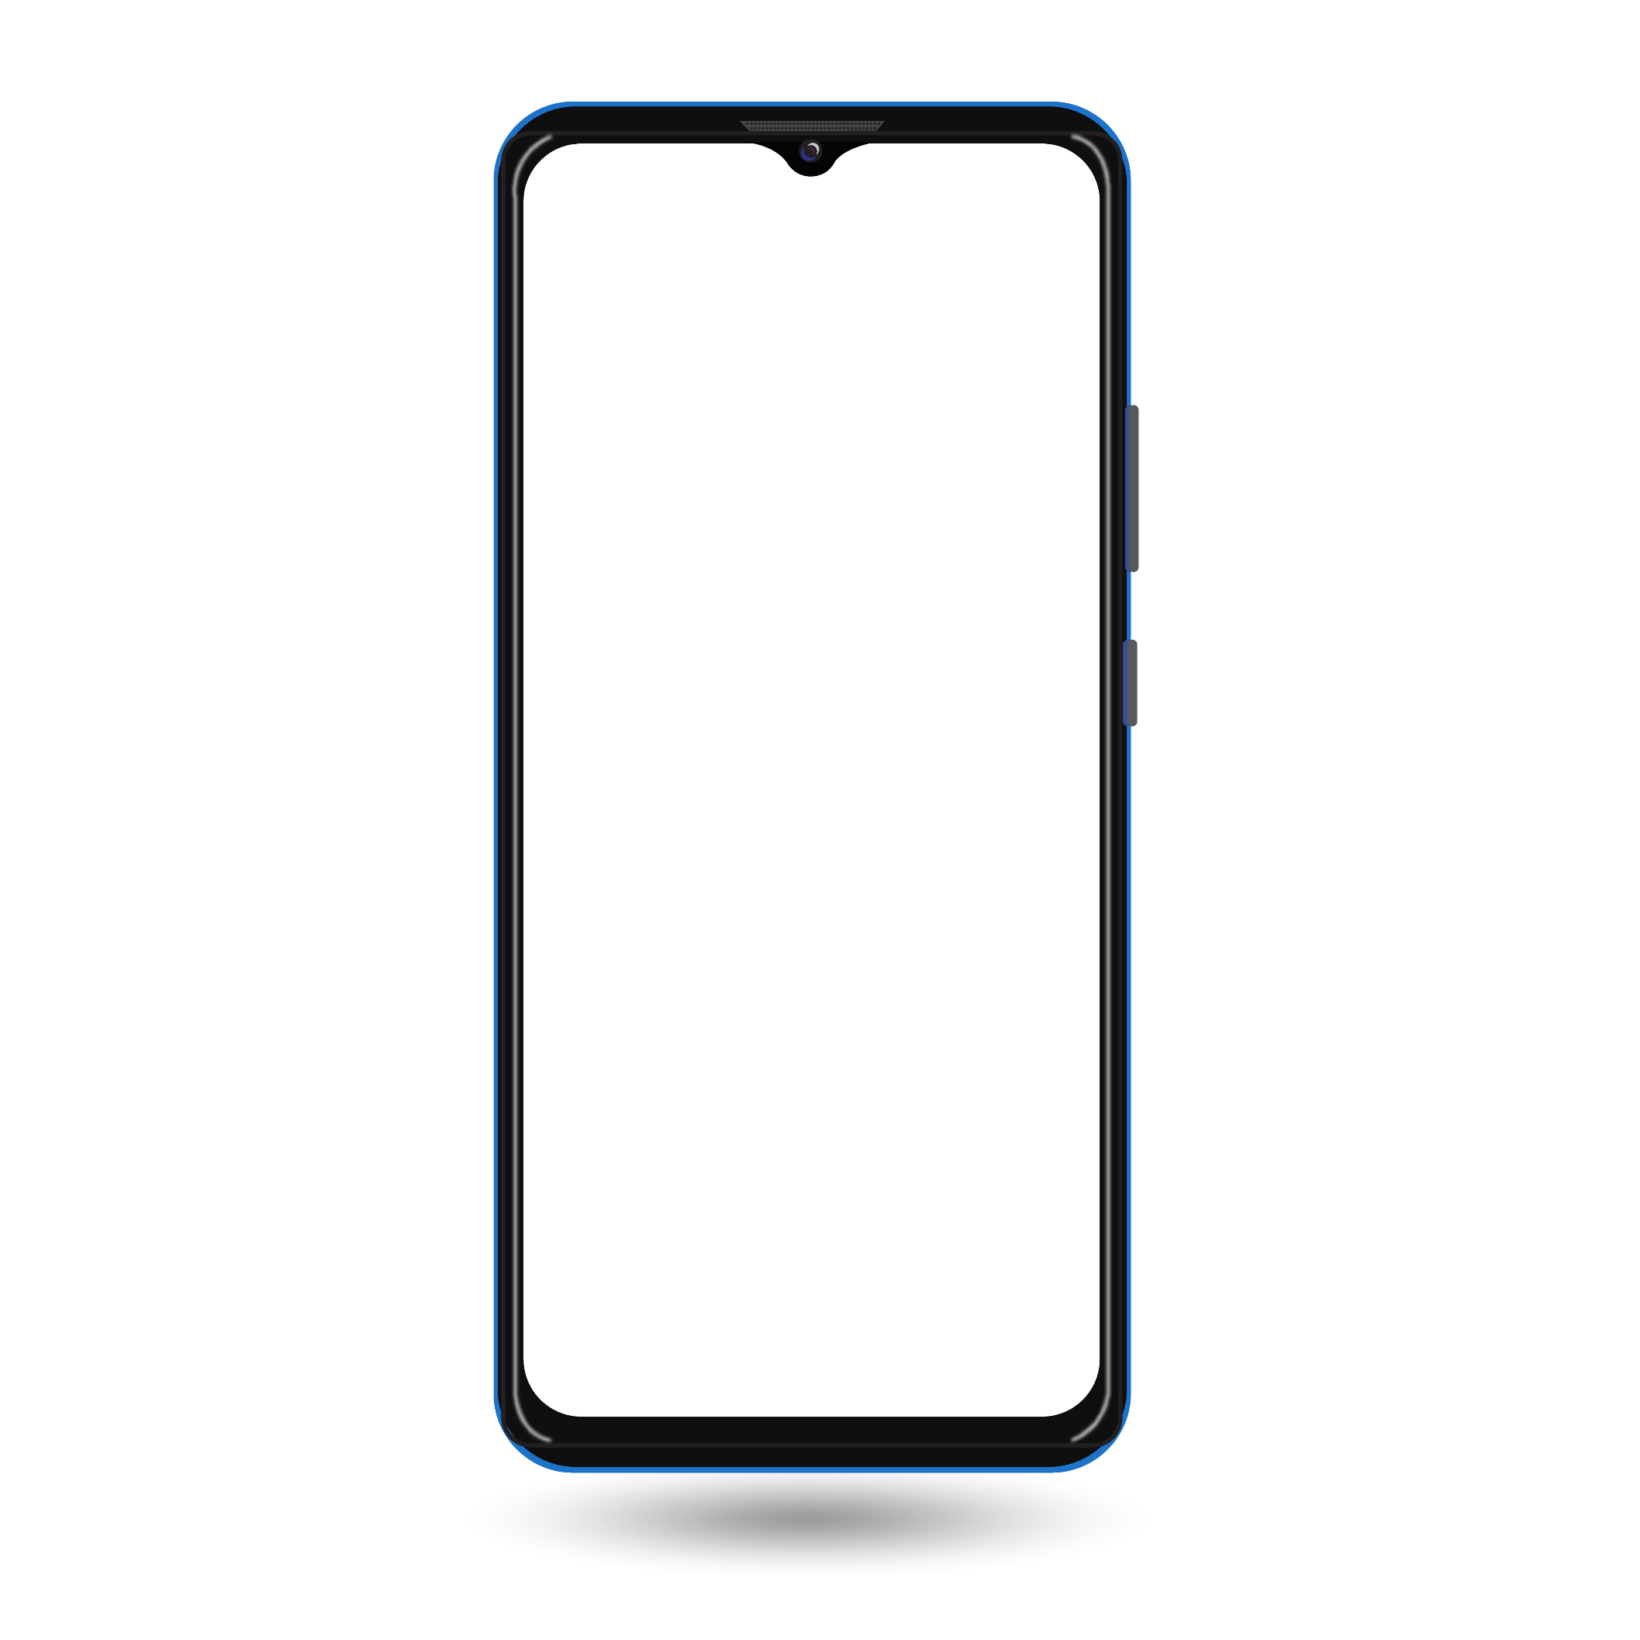

VAULTA
Apps Main
Features
1
User Authentication
6
Pay bills
2
Withdraw Money
7
View exchange rate
3
Transfer money to another account
8
Change language
4
View transactions history
9
Change User’s Info
View account details & add balance.
5

Slide 10
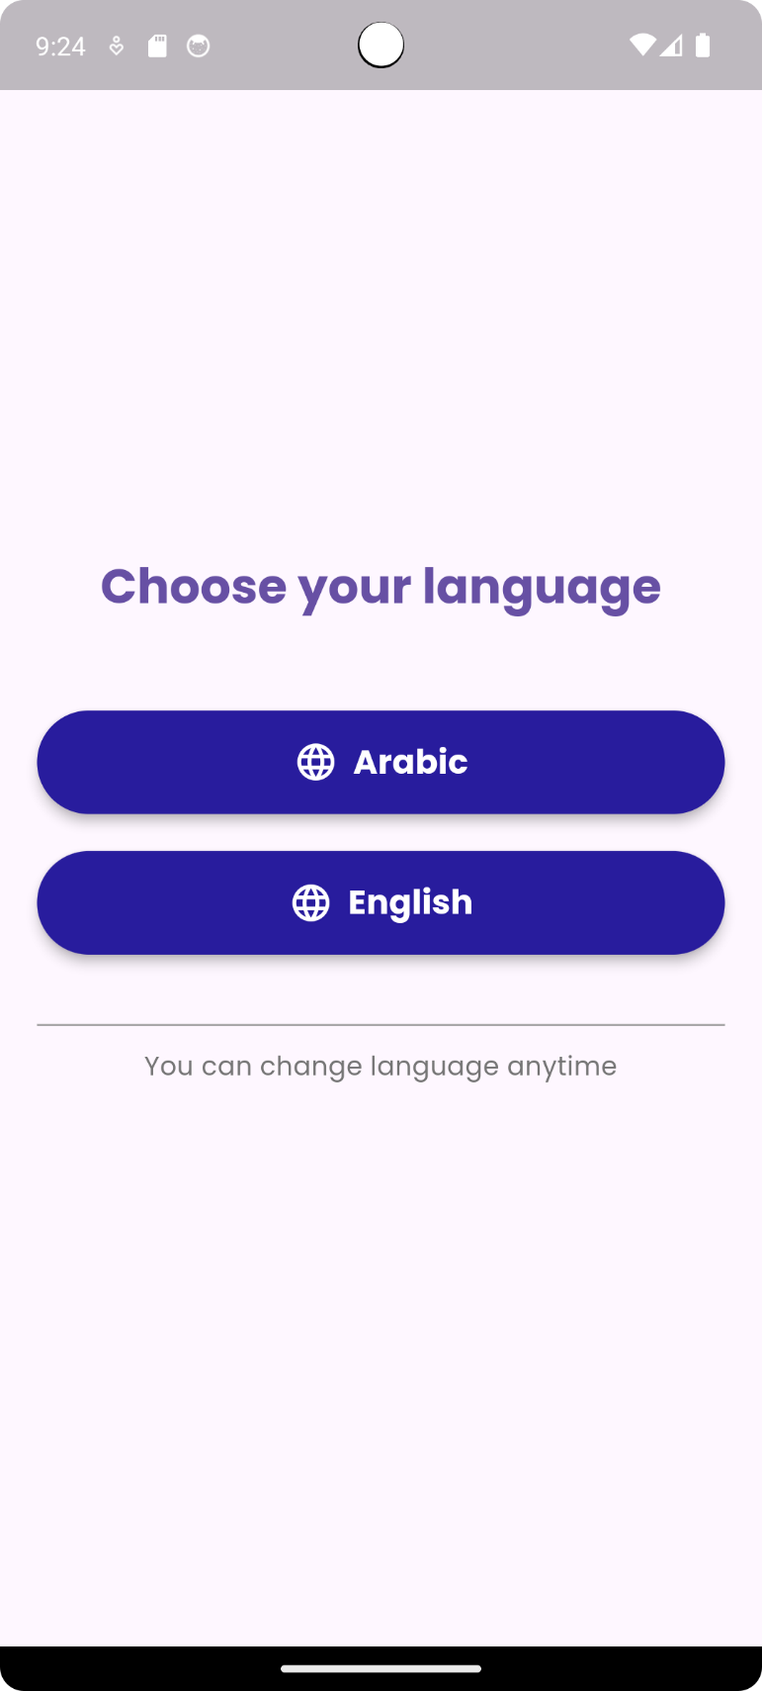
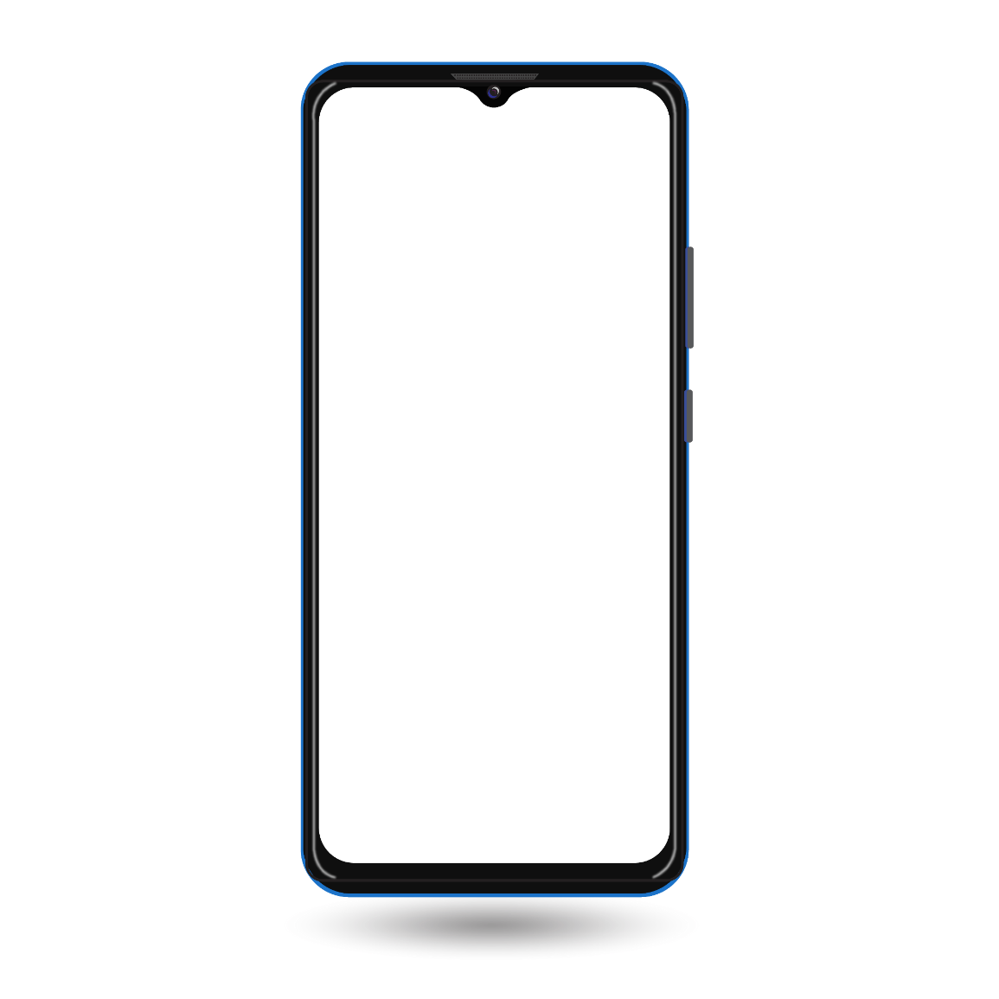
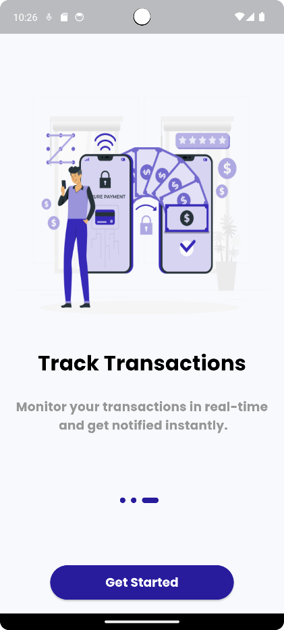
VAULTA
Starting the app
Simple overview:
The user is required to change between 2 languages to proceed into the onboarding screens.
Technical overview:
After choosing, the preferred language is stored into shared preferences.

Slide 11
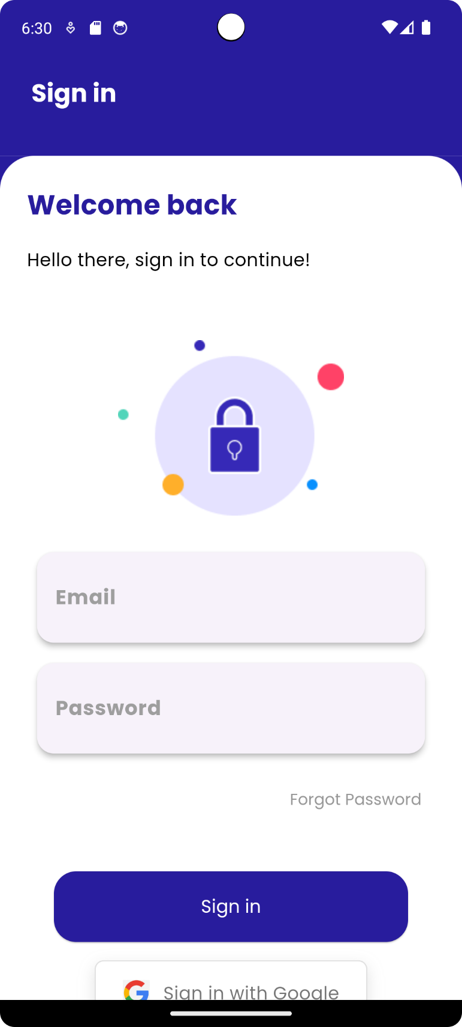
VAULTA
User Authentication
Login
Simple overview:
Authenticated and verified users can log into the app to access their accounts. There is also an option for users to sign in using their Google account for convenience. After logging in successfully the user is redirected to home screen.
Technical overview:
Login Process: Users enter their credentials (email and password) to log in. Firebase Authentication checks the credentials against stored records.
Google Sign-In: The app uses Google Sign-In integration (via Firebase) to allow users to log in with their Google account, streamlining the authentication process.
Only users who have verified their email addresses are allowed to log in. Unverified accounts are prompted to verify their email before accessing the app.
Note: user id token is stored into shared preferences to enable the user using the app’s features without logging in again.
After successfully logging in, the user is redirected to Home screen.

Slide 12
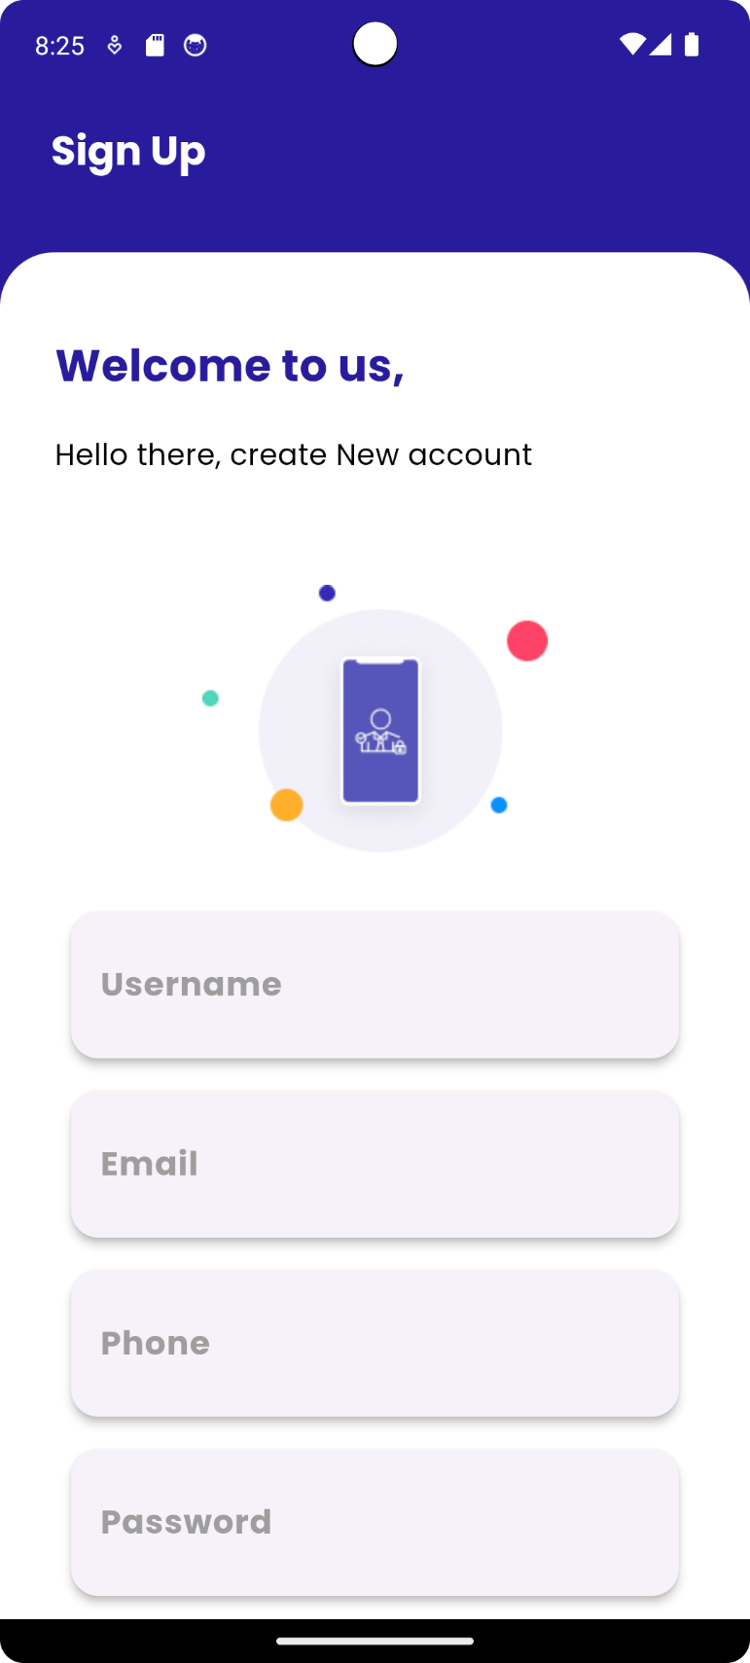
VAULTA
User Authentication
Signup
Simple overview:
New users can register by providing their information. After signing up, they are prompted to verify their email before they can log in.
Technical overview:
Registration Process: Users input their details (name, email, password, etc.) the data is sent to Firebase authentication.
Email Verification: After successful registration, an email verification link is automatically sent to the user's email address using Firebase Authentication's built-in email verification feature.
The user is then redirected to the login screen, but their access is restricted until they verify their email by clicking the verification link.

Slide 13
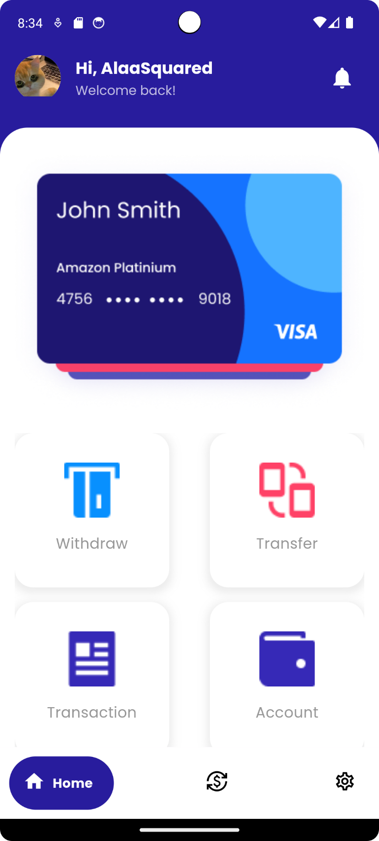
VAULTA
App Screens
Home screen
Simple overview:
Many features can be accessed here:
Withdraw money feature.
Transfer Money to another account.
View Transactions history.
View account details and add balance.
Pay bills.

Slide 14
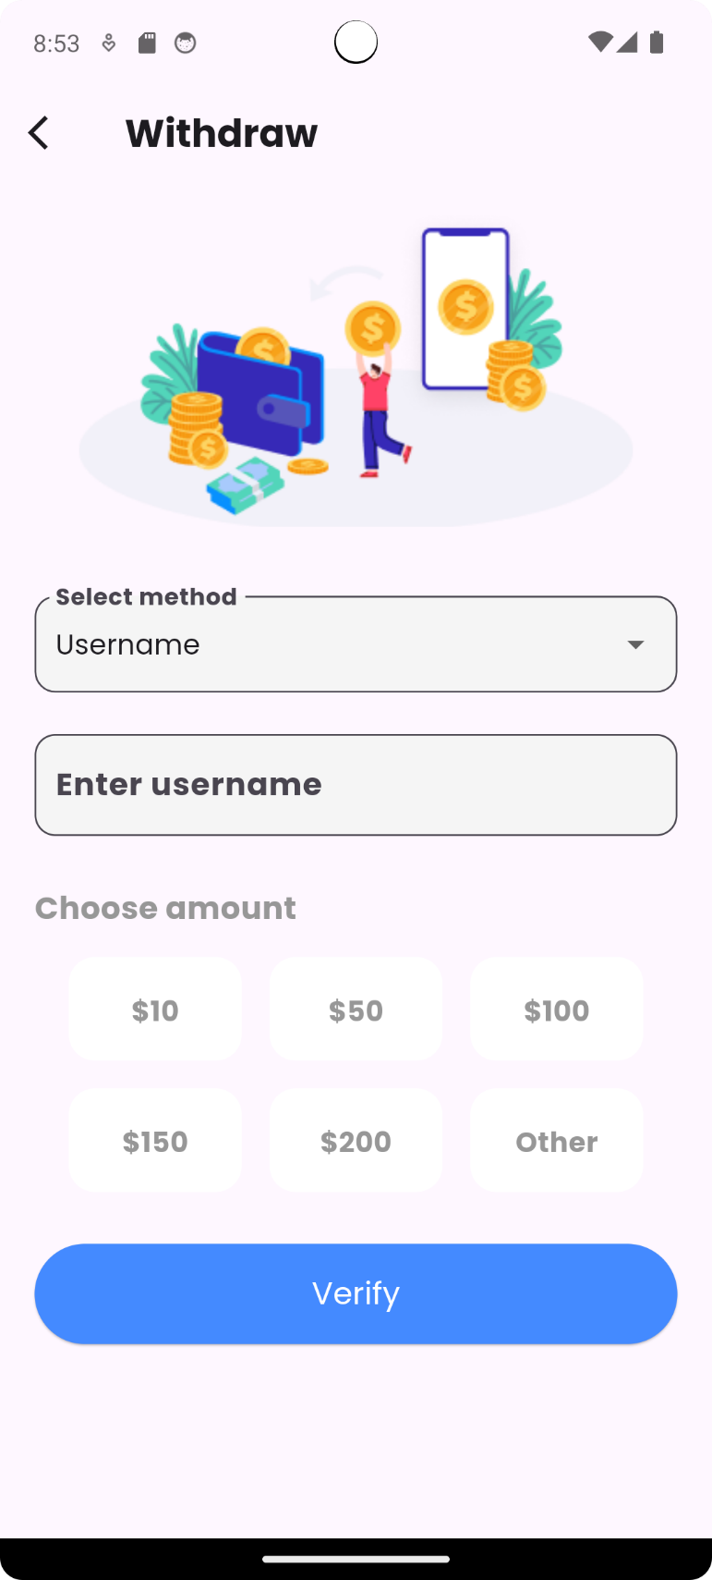
VAULTA
Home Screen: Withdraw Money
Simple overview:
Users are required to write their username or phone number as a verification method, then choose the amount they want to withdraw from their balance.
Technical overview:
Withdrawal process: the amount chosen is withdrawn from balance if valid and the balance data of the user is updated in firebase firestore database.

Slide 15
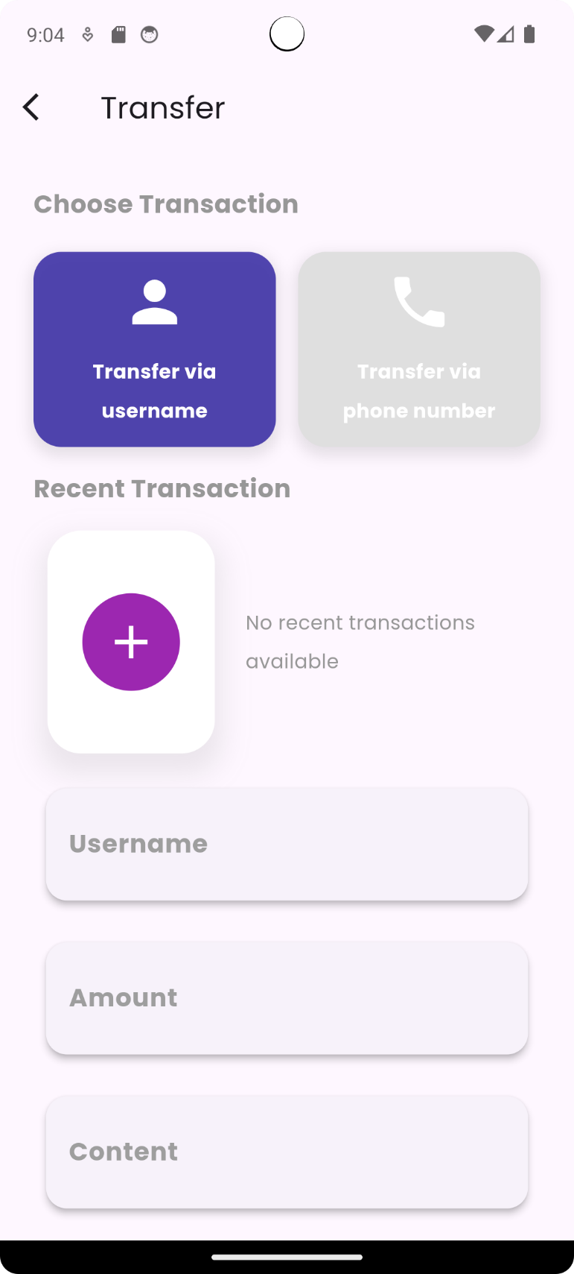
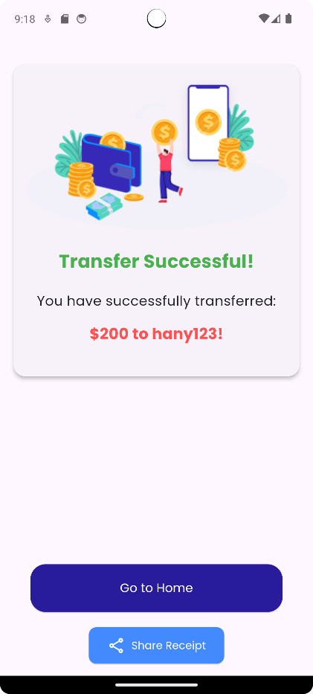
VAULTA
Home Screen: Transfer Money
Simple overview:
Users can transfer money to another account either by that account’s username or phone number. There is an option to add that account to recents so the user doesn’t enter its information upon transferring again.
Technical overview:
the transaction made is stored into firebase firestore database if valid (username is valid and found) and successful.
The user is directed to confirm transaction page to confirm the process.
Note: there is an option to share the transaction.

Slide 16
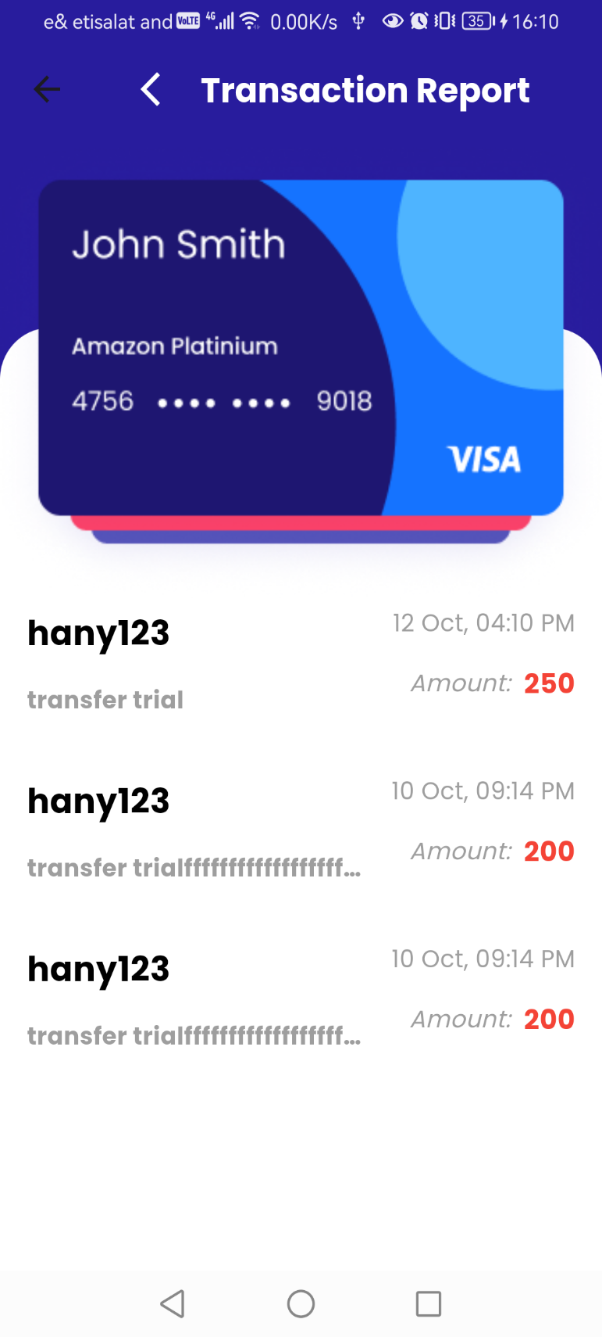
VAULTA
Home Screen: View Transaction history
Simple overview:
Users can view a list of all their past transactions for easy tracking and reference.
Technical overview:
Transaction history is fetched from Firebase Firestore, stored in a cloud-based database, and displayed in a user-friendly format using Flutter widgets.

Slide 17
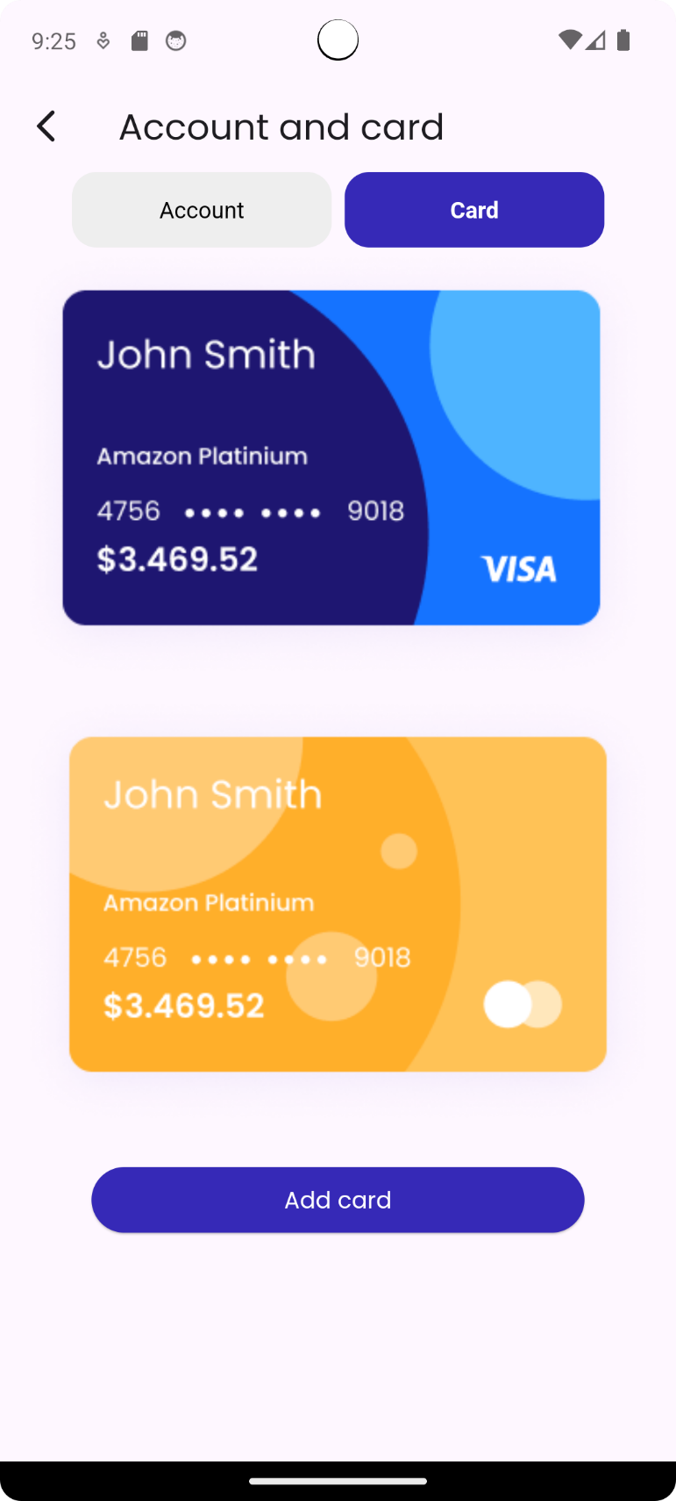
VAULTA
Home Screen: View Account details
Card
Simple overview:
Users can view a list of all their money cards.

Slide 18
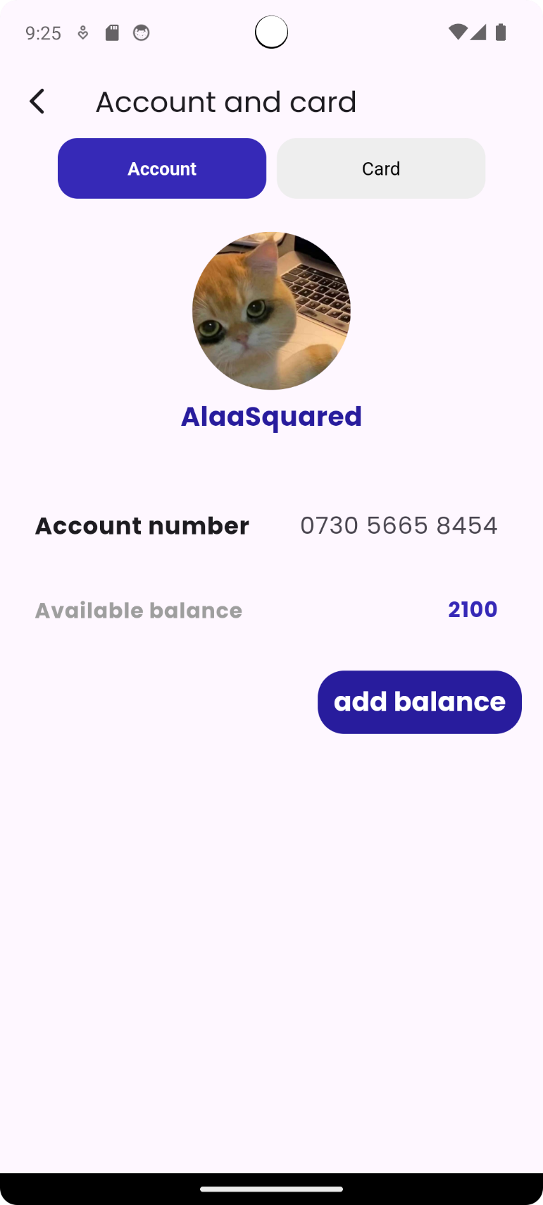
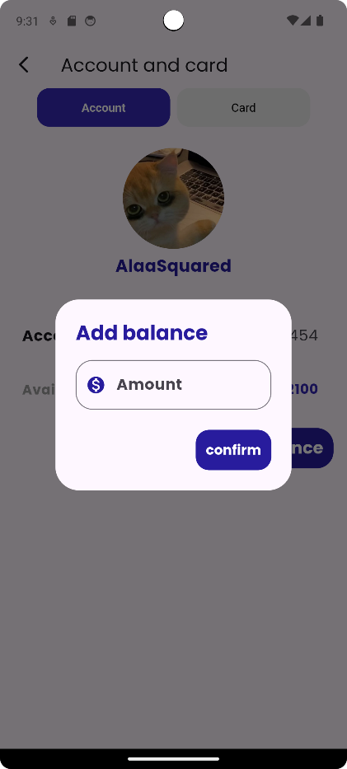
VAULTA
Home Screen: View Account details
Account
Simple overview:
Users can view their account information: their account number and balance. In addition, they can add balance.
Technical overview:
User’s info is fetched from firestore database, a popup appears to enter amount to add, this amount is checked if it is a valid number or not. The amount is added to user’s balance if successful and new balance is updated into firestore database.

Slide 19
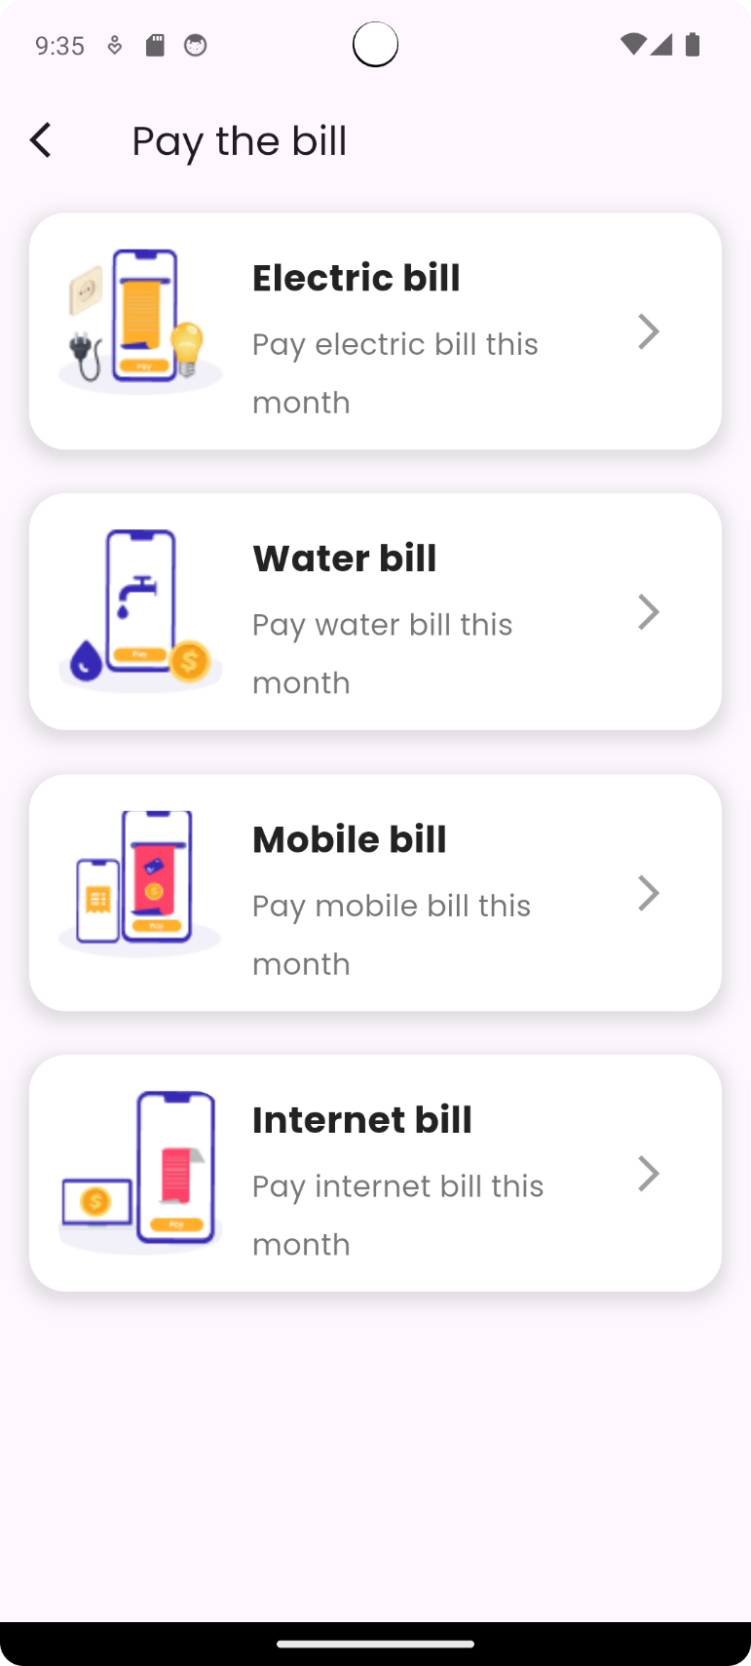
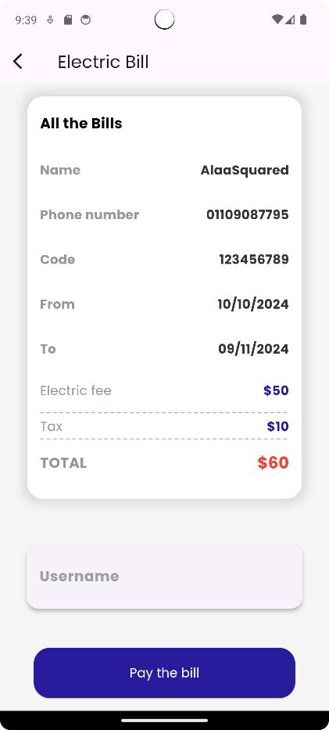
VAULTA
Home Screen: Pay bills
Simple overview:
Users can conveniently pay bills directly through the app for common services like internet, electricity, and water.
Upon clicking on one of then, the user is redirected to the payment page in which the details are displayed.
Technical overview:
User’s data is fetched and payment is successful if only the user has valid amount in their balance. After successful payment, the payment amount is deducted from balance and new balance is updated into firestore database.

Slide 20
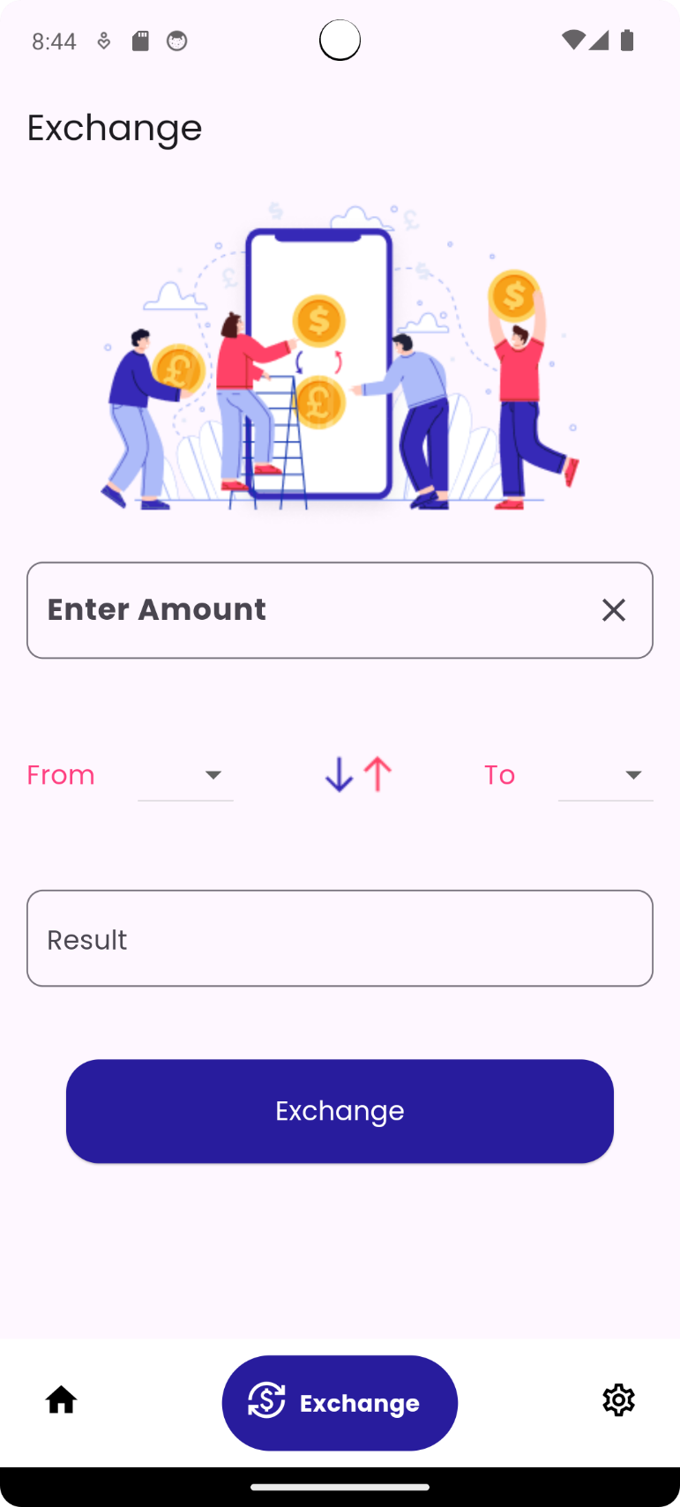
VAULTA
App Screens
Exchange screen
Simple overview:
Users can enter a specific amount in one currency and instantly view its equivalent in another currency.

Slide 21
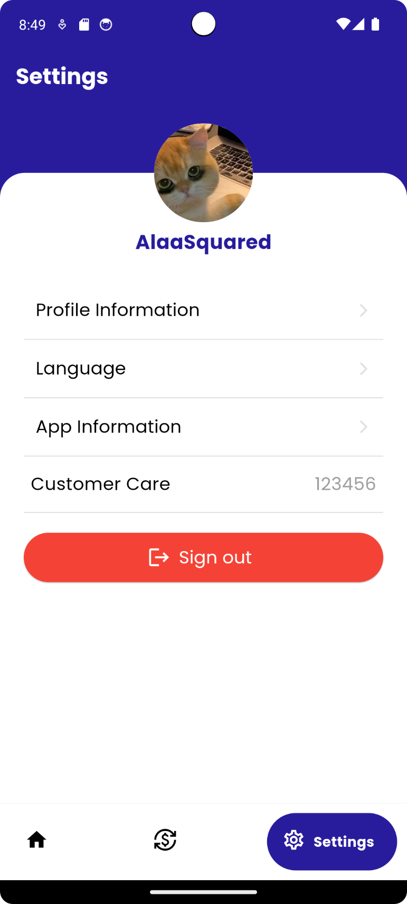
VAULTA
App Screens
Settings screen
Simple overview:
Many features can be accessed here:
View profile information and edit it.
Change language.
View app information.
Sign out.

Slide 22
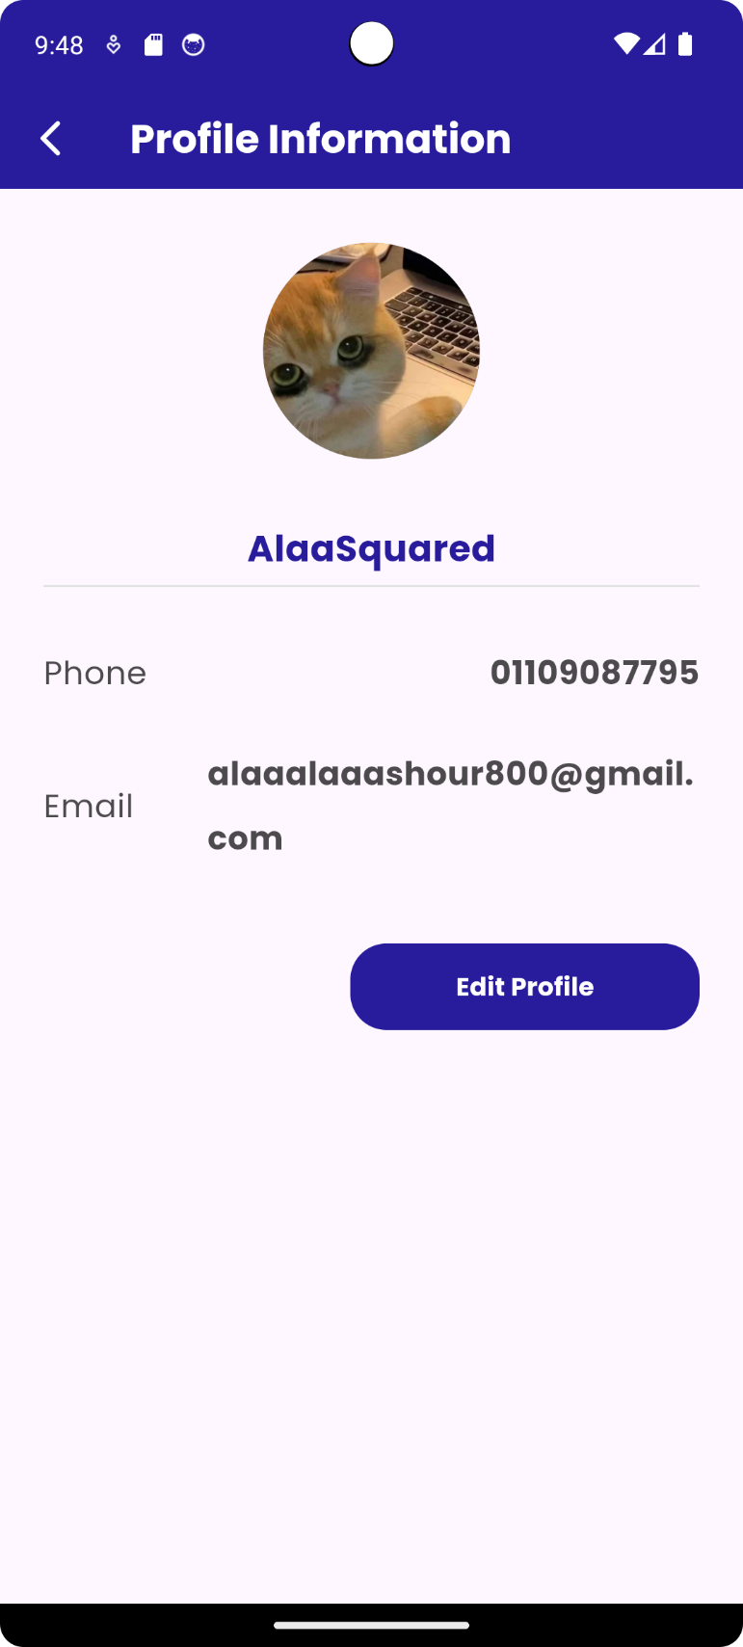
VAULTA
Settings Screen: View profile information
Simple overview:
User’s info is displayed (profile picture, username, phone, email). There is an option to edit any of them. Upon clicking on that button user is redirected into edit page.
Technical overview:
User’s data is fetched from firebase firestore into the UI.

Slide 23
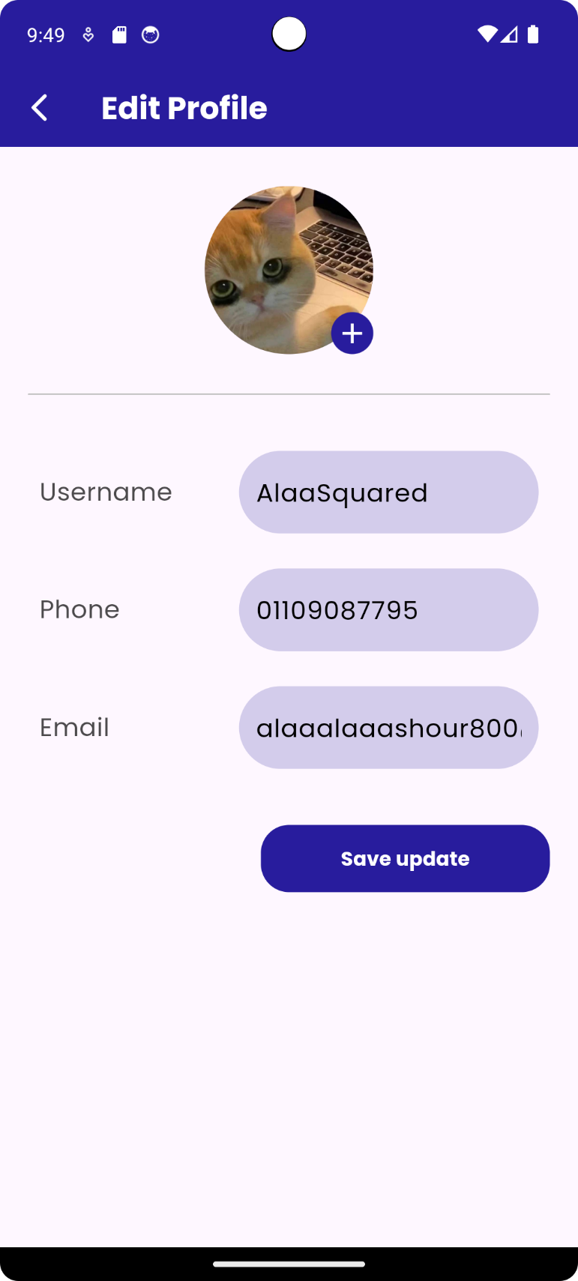
VAULTA
Settings Screen: Edit profile information
Simple overview:
User can pick an image from their gallery, change username, phone and email.
Technical overview:
Upon confirming edit, username, phone and email are checked if they are valid by fetching all other users’ information and making sure no other user has that new username, phone or email.
If not valid, the user is required to change the information that is not valid.

Slide 24
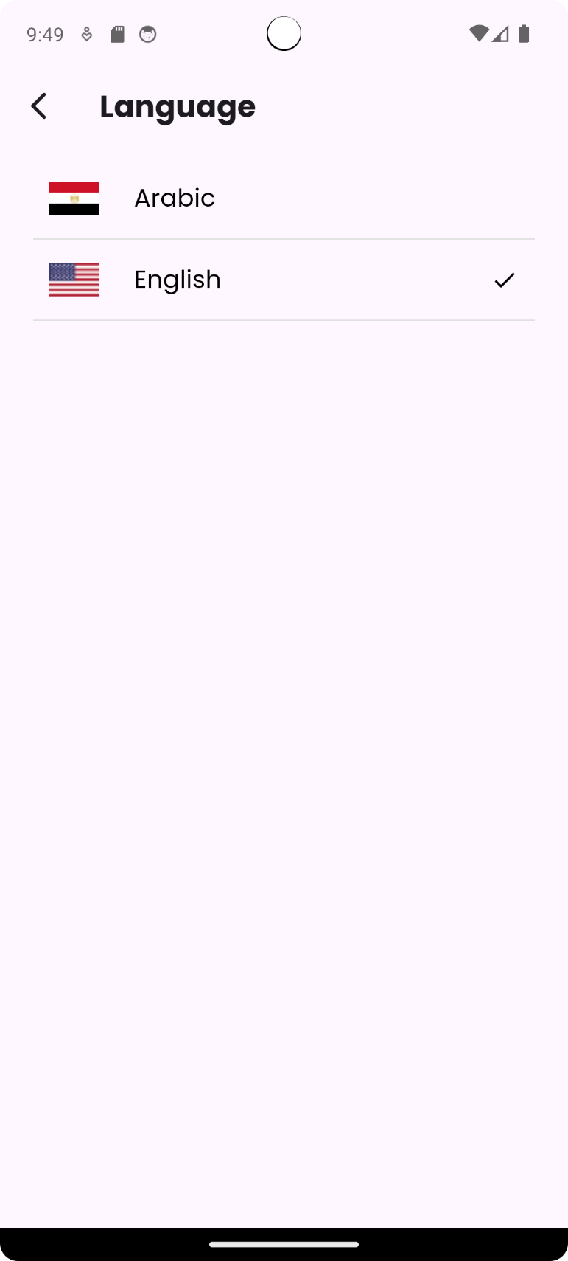
VAULTA
Settings Screen: Change Language
Simple overview:
User can change the app’s language according to their preferences.
Technical overview:
The chosen language is stored into shared preferences, thus when exiting the app and re-entering it the chosen language doesn’t change.

Slide 25
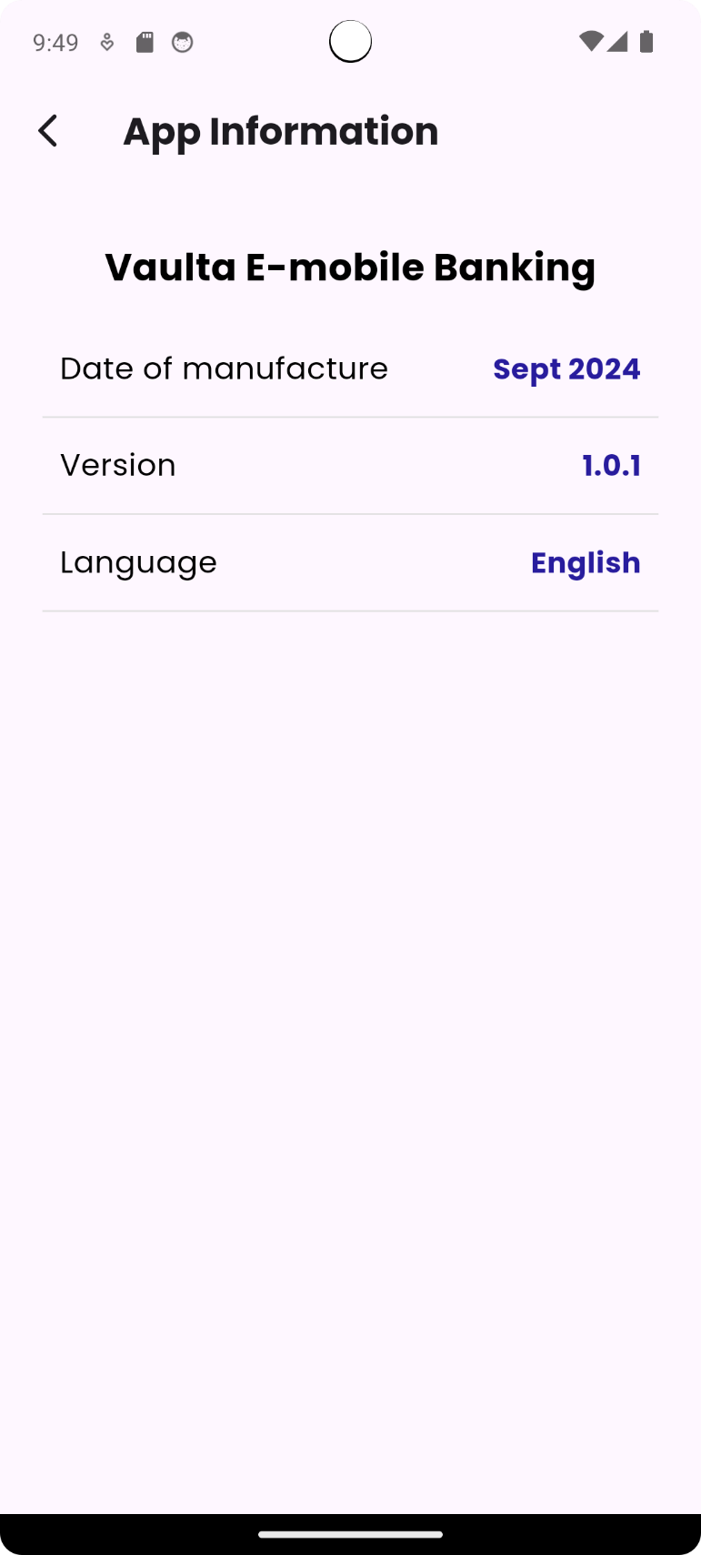
VAULTA
Settings Screen: View app info
Simple overview:
App information is displayed.

Slide 26
VAULTA
Settings Screen: Sign out
Simple overview:
Upon signing out, the user is redirected to login page.
Technical overview:
The user id token is removed from shared preferences and the user is signed out from firebase.

Slide 27

Summary
Vaulta is a secure and intuitive financial app designed to simplify personal finance management. It offers features like money transfers, bill payments, and currency exchange, ensuring users can manage their funds conveniently from their mobile devices. With strong user authentication and a focus on ease of use, Vaulta provides a seamless and secure solution for everyday financial tasks.

Slide 28
Thank You!

